Slide 1

Hussein Kassir

Slide 2


Academic Background & Skills
BS Pharmacy
Pharmacology
Therapeutics
Pharmacokinetics
Pharmacogenomics
MSc Genomic Medicine
Introduction to Bioinformatics
Molecular Pathology of Diseases
Omics techniques
Ethics

Slide 3
Research Experience
Two Core Research Projects:
Genotype-Phenotype Correlations in Neurodevelopmental Disorders (NDDs)
Functional Genomics and Drug Targets
WHRI PhenoGenomics group:
Prof Damian Smedley
Dr Pilar Cacheiro

Slide 4

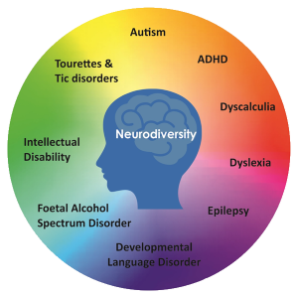
NDDs Affect Brain Development and Function
Image from Autismtoolbox.co.uk, showing the range of neurodevelopmental 'disorders’.
NDDs Comorbidities
Prevalence: ~ 15 % - M>F (Gidziela et al. 2023)
Notes:
Prevalence Globally

Slide 5


Identifying Genotype-Phenotype Correlations in NDDs
Aim was to capture phenotypic enrichments for known disease-causing genes
Aid in management modalities and better understanding
100,000 Genomes Project ( ~5000)
Focus on patients with a molecular diagnosis in genes recruited under ID ( >10 Diagnoses) due to time constraints
Left with around 400 Patients data points
R programming :
Data Wrangling
Statistical analysis
Notes:
GE’s Research Summit on June 17^{th.}

Slide 6
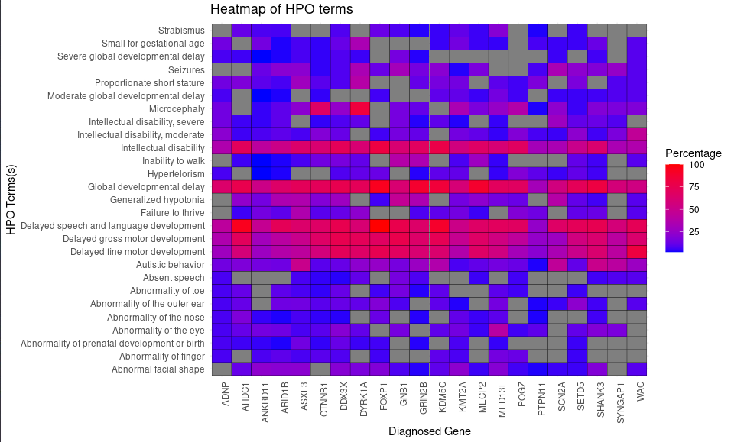
SCN2A plays a critical role in social development
Fisher’s Exact Tests that loops through each gene and HPO term combination
Multiple Gene-Phenotype relationship with nominal significance
After correction : SCN2A - Delayed Social Development ( P adj. : 4.632 × 10⁻⁴)
Supporting research linking SCN2A to ASD (Reynolds, C., et al 2020)
Suggests SCN2A’s link to pathways related to language processing and emotional development
Notes:
Build a 2x2 contingency table for each combination sodium voltage-gated channel alpha subunit 2 For each gene-HPO pair, it counts
A: The gene and the HPO term appear together. “Benjamini-Hochberg (BH)” BH correction is more powerful than Bonferroni correction, particularly when there are a large number of tests
B: The gene appears without the HPO term.
C: The HPO term appears without the gene.
D: Neither the gene nor the HPO term appear together.

Slide 7
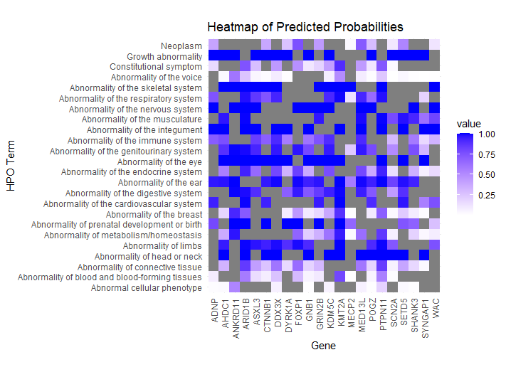
Supervised Machine Learning Model
Logistic regression model on a binary contingency table of Gene/HPO term
Aims to predict phenotypes according to the diagnosed gene in the subset of Mendelian ID
Split into a training (60%) and test (40%) sets
Calculating the Predictive Probabilities

Slide 8
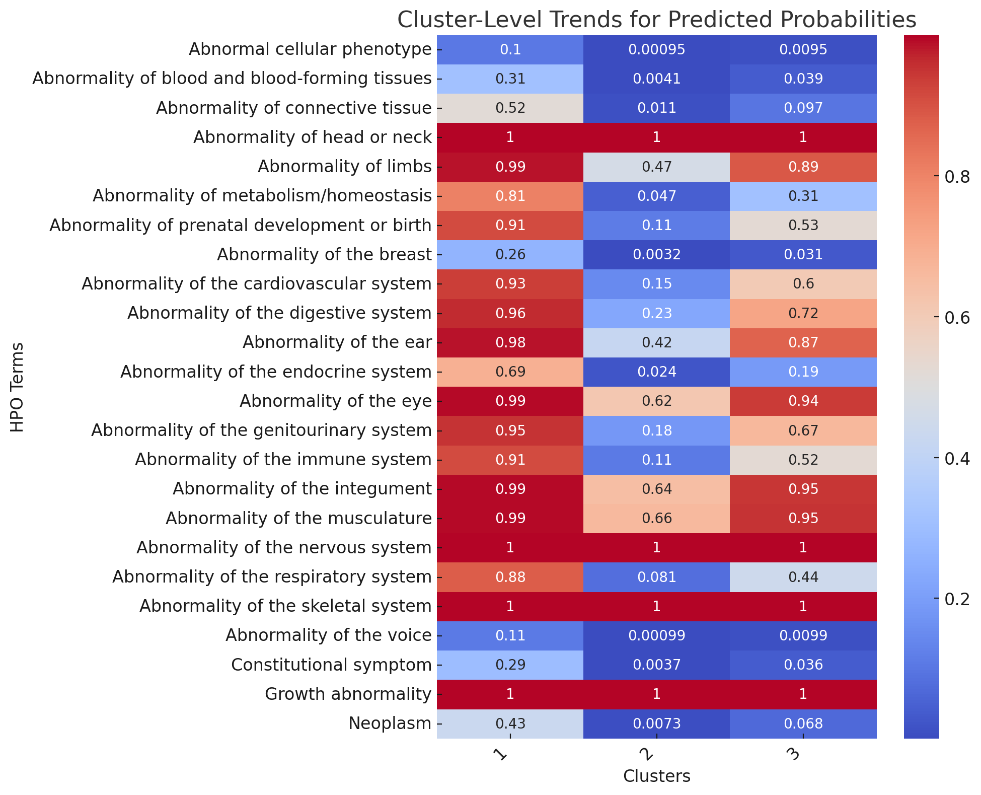
The Wnt/β-catenin pathway may be a common mechanistic link of disease manifestations in genes from Cluster 1
Performed K mean clustering
DDX3X:
Sex differences noted:
In males: early post-implantation lethality
In females: placental abnormalities and embryonic lethality (Chen et al. 2016)
CTNNB1:
Implicated in uterine and ovarian cancers. (Liu et al., 2014, J Natl Cancer Inst)
Involved in embryogenesis via Wnt/β-catenin signaling
MED13L:
In cardiac tissue, linked to the Wnt/β-catenin pathway (Gardner et al. 2022)
Notes:
Cluster 1 Genes: ANKRD11, ARID1B, ASXL3, CTNNB1, DDX3X, FOXP1, KMT2A, MED13L, PTPN11, SETD5

Slide 9
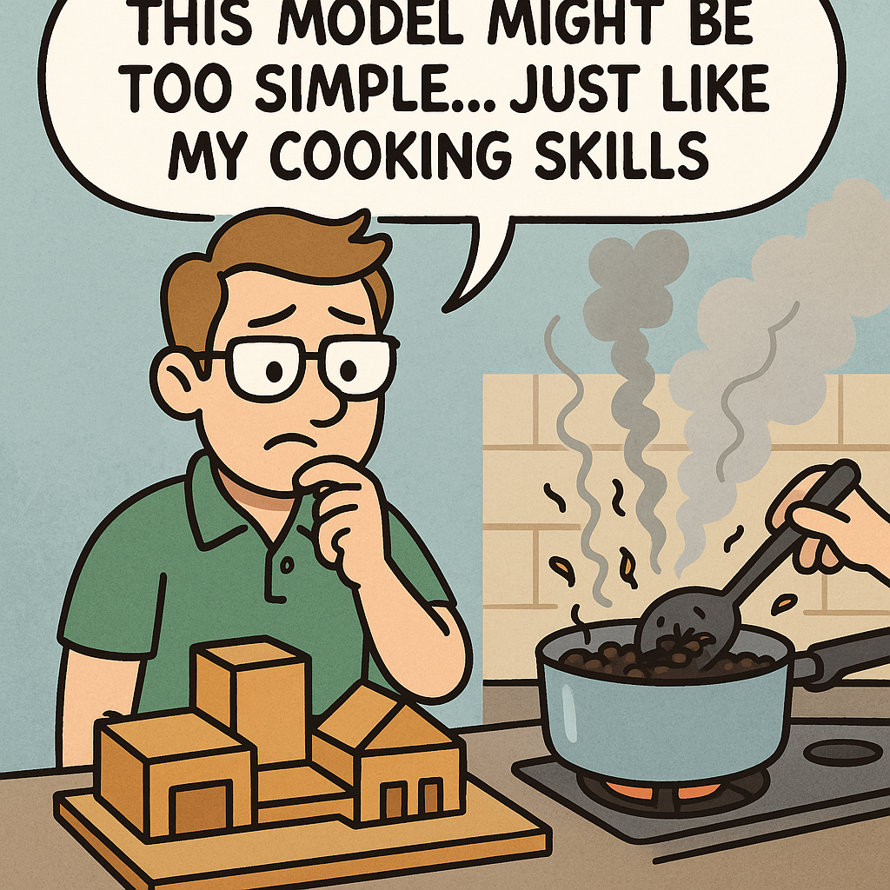
Limitations:
Small sample size.
HPO annotations could be misleading.
Under-representation of certain ethnic and socio-economic group.
The LR model is simplified:
Unidimensional : Only included genes and phenotypes — no additional variables.
High Bias with the Cross-Validation Step
The results were very similar to the original data (Overfitting)
Notes:
Hold Out Method
Better to use K-Fold Cross validation

Slide 10
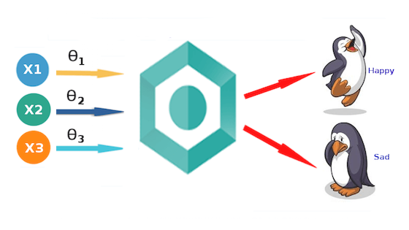
How can we improve ?
More input variable such as variant type and variant location to create multidimensional model.
Integrated transcriptomics or proteomics signatures
Used a different cross validation methods i.e. K fold
Confusion matrix
Notes:
I would have rebuilt a model that will include more input variable such as variant type, variant location, environmental factors.
How?

Slide 11
Annex

Slide 12
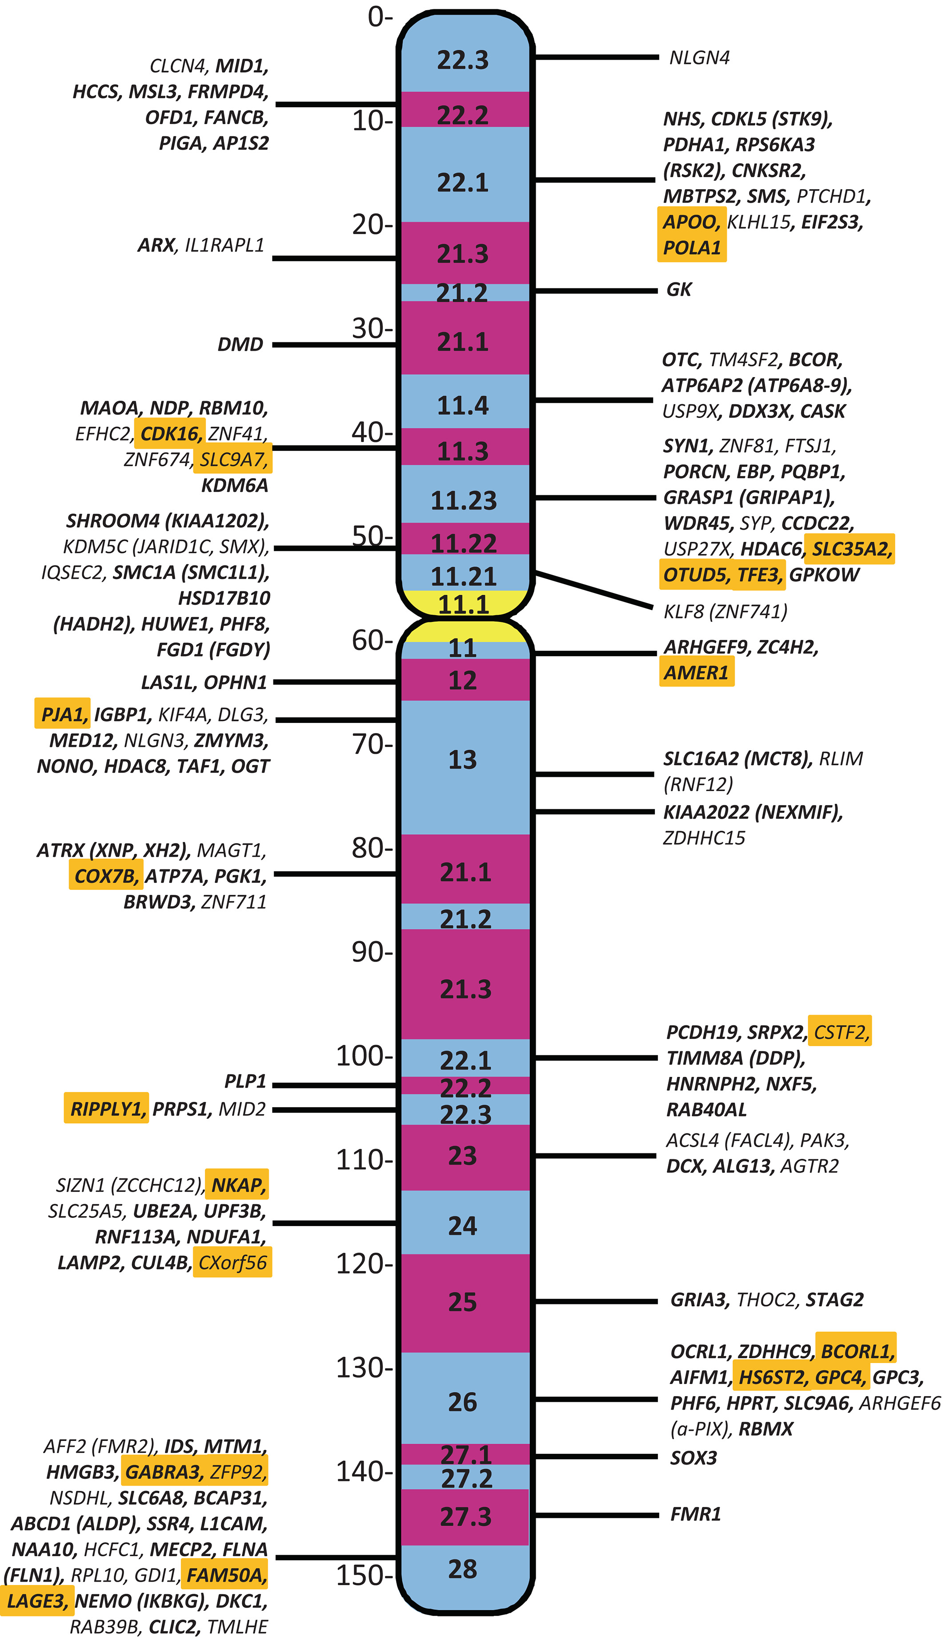
X chromosome with location of the 162 genes that are associated with intellectual disability.
American J of Med Genetics Pt A, Volume: 191, Issue: 1, Pages: 144-159, First published: 27 October 2022, DOI: (10.1002/ajmg.a.63008)

Slide 13
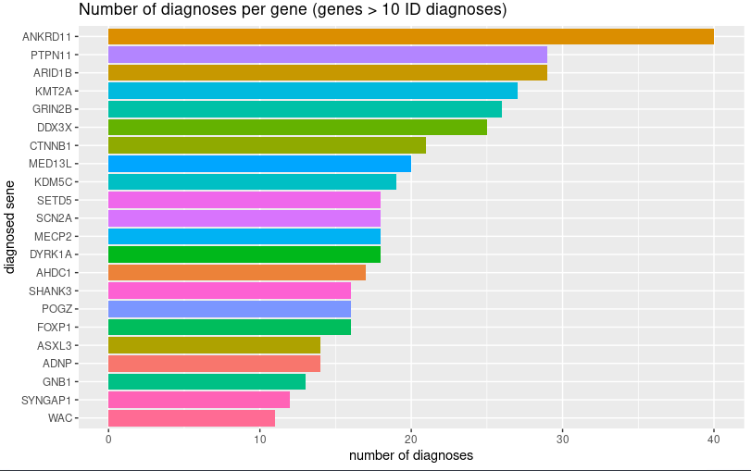

Slide 14
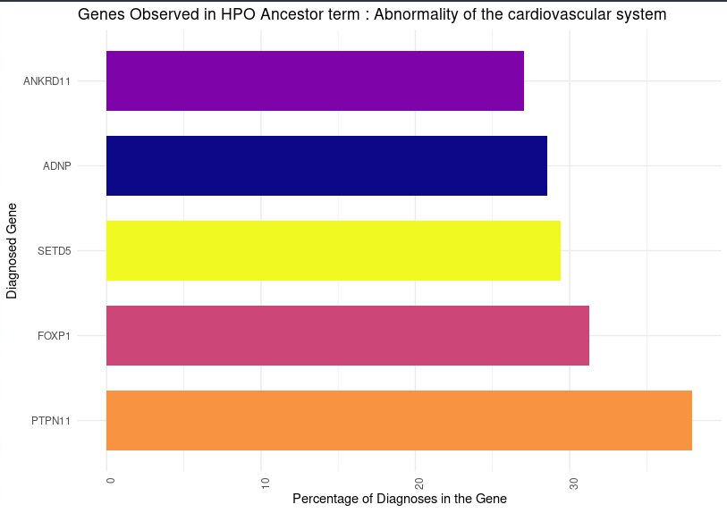
MED13L - “Abnormality of the eye”
ADNP, PTPN11 & SETD5 - “Abnormality of the ear”
Musculature abnormalities are highest in GNB1 (69.2%), ASXL3(50%), and CTNNB1
PTPN11, FOXP1, SETD5, ADNP & ANKDR11 – “Abnormalities of the CV system”

Slide 15
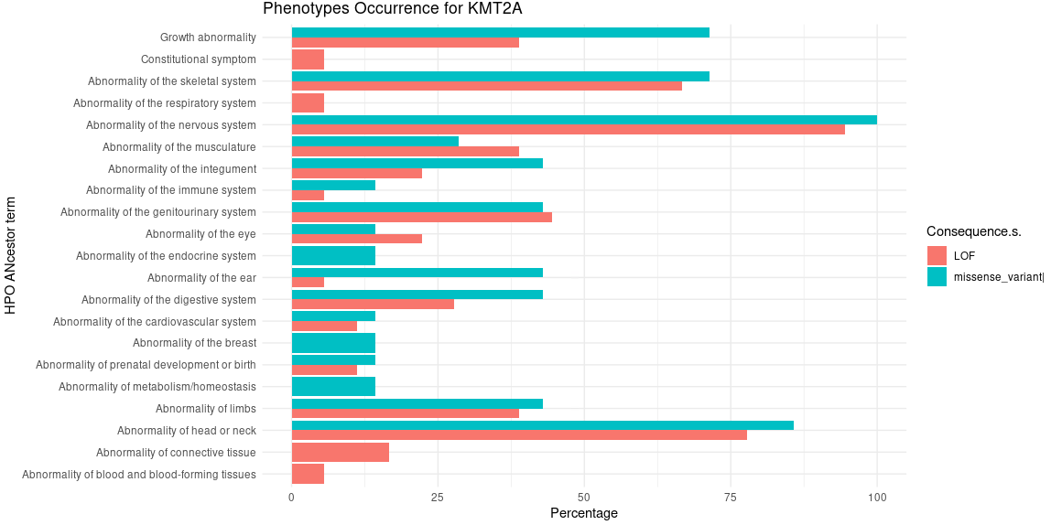

Slide 16
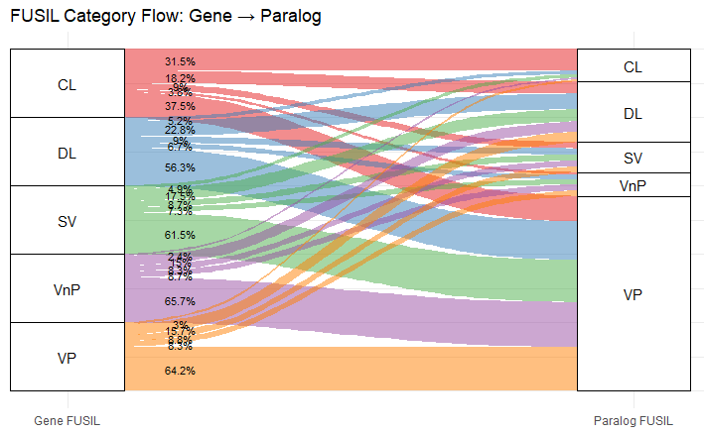
Check for side effects patterns that matches the biological roles of the paralogues.
This can add a layer for better understating the SE patterns of drugs

Slide 17
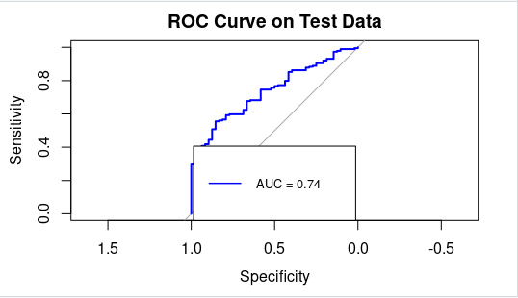
What Model Did We Use?
Logistic Regression Model
A type of generalized linear model (GLM) designed for binary outcomes (0/1).
Models the log-odds of observing a gene–HPO term pair as a function of the gene and the HPO term.
Why this model?:
it’s interpretable, handles binary data, and quantifies gene and phenotype contributions.

Slide 18
How to integrate ML and what types
Literature review on methodologies
PCA and single vector machine
Clustering algorithm

